Slide 1
Node
Intro to Node
Command Line Interface
NPM
Creating and running a project

Slide 2
Intro to Node
Javascript was released in May 1995
Javascript was primarily used for client side scripting.
In 2009 Node.js arrived and is a runtime environment using the Google V8 runtime engine to execute Javascript code outside of the browser.
Node is written in C, C++ and JavaScript.
As V8 supports new feature in Javascript they are incorporated into Node.
Node.js applications are written in JavaScript, and can be run within the Node.js runtime on OS X, Microsoft Windows, and Linux.

Slide 3
Intro to Node
Node.js uses an event-driven, non-blocking I/O model that makes it lightweight and efficient, perfect for data-intensive real-time applications that run across distributed devices.
Non-blocking or Asynchronous I/O is a form of input/output processing that permits other processing to continue before the input or output has completed.

Slide 4
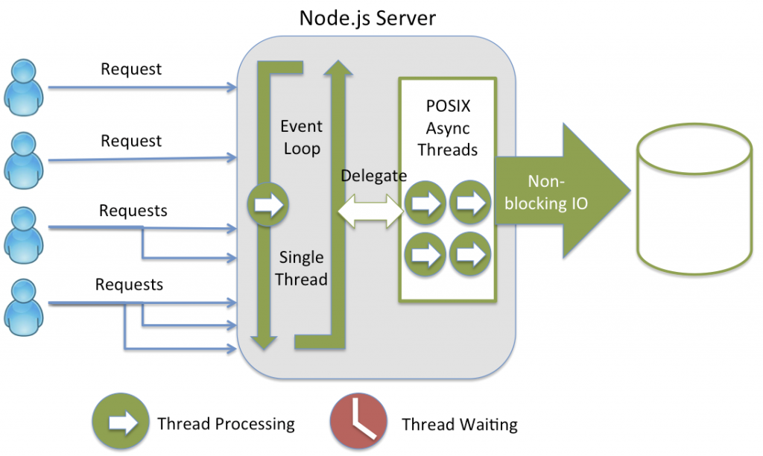
Intro to Node
Node.js is an event driven server side language that manages the events in a queue as an event loop. Then with the Event loop it is delegated into asynchronous tasks that manages to create a non-blocking IO (input output) to the user.

Slide 5
Web Frameworks
After building multiple projects, the biggest thing is you realise is that the same code is being written over and over again.
Web Frameworks provide APIs and commands that automate web app tasks and make your coding time shorter.
Web frameworks introduced many concepts that have been adopted in most frameworks today:
Convention over Configuration (CoC)
Don’t repeat yourself (DRY)
Using REST
MVC
Don’t Re-invent the Wheel
Notes:
Ionic was first released by a company called Drifty in 2013
Ionic was developed to address some of the limitation of jQuery Mobile primarily the UI components available.
The current version of Ionic is Ionic 4 released in January 2019

Slide 6
Don’t Re-invent the Wheel
In Node.js, Don’t Re-invent the Wheel is an important convention. This is why Node.js has a package management system called NPM.
NPM is the world’s largest software library.
NPM is also a Package Manager and Installer via its command line interface
NPM is installed with Node.

Slide 7
How to Install Node
Windows:
Go to https://nodejs.org and press the download link and install.
Mac:
First install Homebrew by following the instructions from here:
https://brew.sh/
In your terminal type:
Brew install node
Node Website
https://nodejs.org

